Slide 1
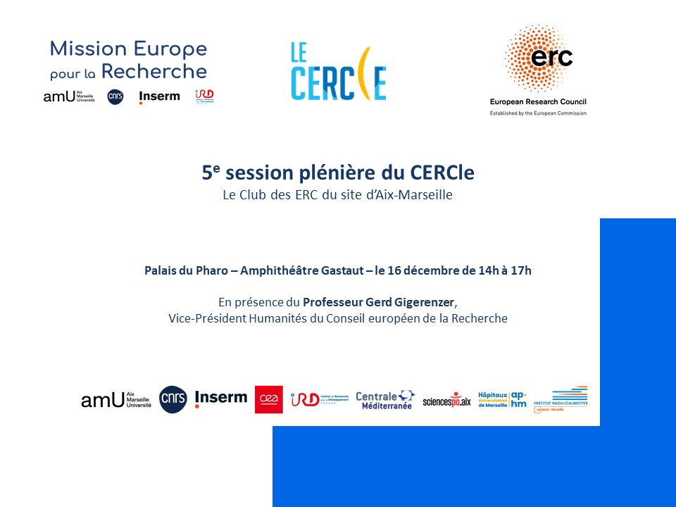
5th Plenary session CERCle
The Aix-Marseille ERC Club
Pharo Palace – Amphitheatre “Gastaut” – 16 December 14h-17h
With Professor Gerd Gigerenzer
Vice-President for Humanities at the European Research Council

Slide 2
Programme: CERCle Plenary Session
2:00 PM Opening Address: Speech by the President of AMU
2:10-2:40 PM Presentation of some ERC-Funded Projects:
Isabelle Dautriche (ERC StG): Formative and Evolutionary Origins of the Language of Thought
Olivier Sulpis (ERC StG): Investigating Environmental Geosciences
2:40-2:55 PM Annual CERCle Report: Review of 2024 and Prospects for 2025
3:00-3:45 PM Presentation of some ERC-Funded Projects:
Maud Gratuze (ERC StG): Mechanisms of Synaptic Degeneration in Alzheimer’s Disease
Christian Henriot (ERC AdG and PoC): Big Data and Power Networks in Modern Urban China
Kristof Strijkers (ERC CoG): Language in Dyads: Connecting Linguistic and Neural Alignment
3:50-4:50 PM Keynote by the ERC Humanities Vice President: “Demystifying the ERC and Encouraging Applications”
Open Discussion and Q&A Session
4:50-5:00 PM Closing Remarks by the Vice-President for Research

Slide 3



Welcome
Eric BERTON
President of Aix Marseille Université
Stefan ENOCH
Vice President for Research
5th Plenary session CERCle
The ERC Club of Aix Marseille

Slide 4
Scientific presentation ERC Laureates (1/2)

Slide 5

Isabelle Dautriche
ThoughtOrigins : Formative and Evolutionary Origins of the Language of Thought StG 2024 – SH4
CRPN - Centre de Recherche en Psychologie et Neurosciences
Notes:
Isabelle Dautriche (ERC StG): ThoughtOrigins : Formative and Evolutionary Origins of the Language of Thought.
Olivier Sulpis (ERC StG): Deep-C :Investigating Environmental Geosciences.
Maude Gratuze (ERC StG): SynApoE: Mechanisms of Synaptic Degeneration in Alzheimer’s Disease.
Christian Henriot (ERC AdG and PoC): HistText : Big Data and Power Networks in Modern Urban China.
Kristof Strijkers (ERC CoG): LaDy: Language in Dyads: Connecting Linguistic and Neural Alignment.

Slide 6
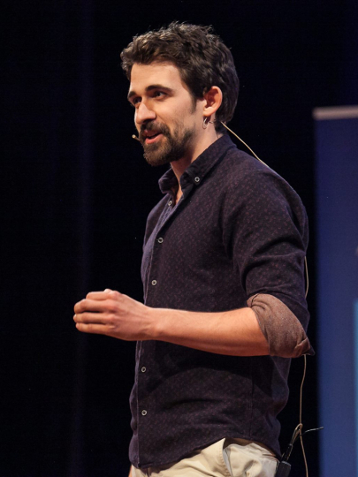
Olivier Sulpis
Deep-C: Investigating Environmental Geosciences StG 2024 – PE10
CEREGE - Centre de recherche et d’enseignement des géosciences de l’environnement
Notes:
Isabelle Dautriche (ERC StG): ThoughtOrigins : Formative and Evolutionary Origins of the Language of Thought.
Olivier Sulpis (ERC StG): Deep-C :Investigating Environmental Geosciences.
Maude Gratuze (ERC StG): SynApoE: Mechanisms of Synaptic Degeneration in Alzheimer’s Disease.
Christian Henriot (ERC AdG and PoC): HistText : Big Data and Power Networks in Modern Urban China.
Kristof Strijkers (ERC CoG): LaDy: Language in Dyads: Connecting Linguistic and Neural Alignment.

Slide 7
Annual CERCle Report:
Review of 2024 & Prospects for 2025
Céline DAMON
Coordinator of ‘Le CERCle’ Head of Mission Europe pour la Recherche (MER)

Slide 8
Overview of ERC laureates of Aix-Marseille

Slide 9

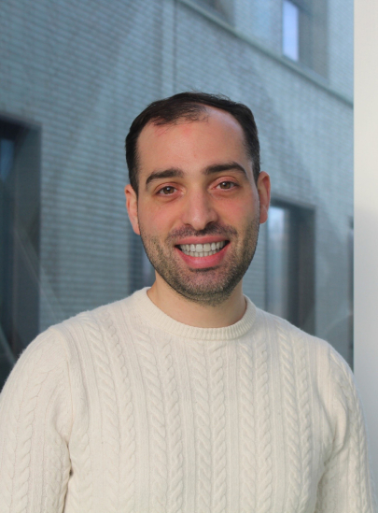
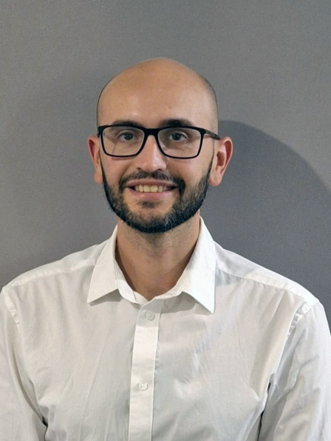
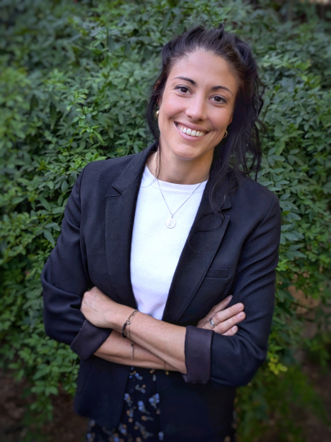
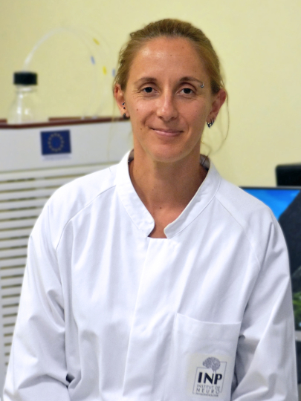
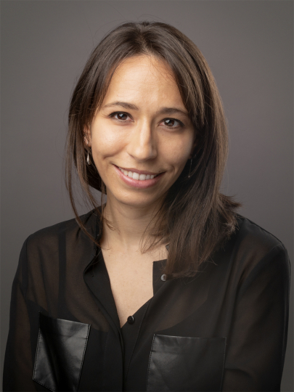
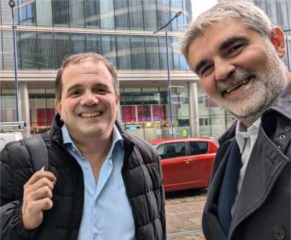
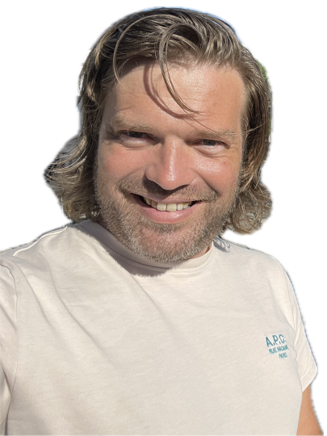
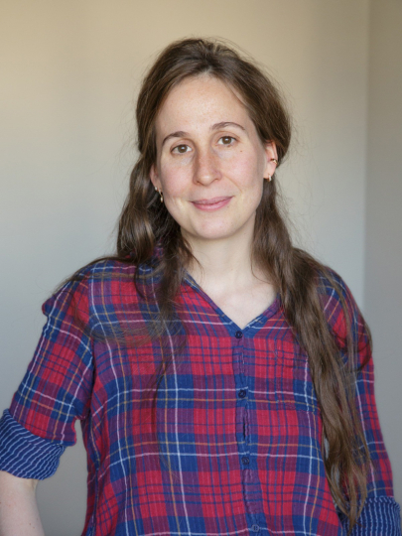


9
Meet our new laureates of the year!
Hugo BISIO-SABARIS StG – LS8 - IGS ViDaMa Proving the causality of liquid-liquid phase separation for the acquisition of nuclear-like functions by the viral factories of giant viruses
Aix Marseille 100th ERC Laureate! Maud GRATUZE StG – LS5 - INP SynApoE Unravelling ApoE4 contribution to tau-mediated synaptic degeneration in AD by combining advanced proteomics and super resolution microscopy
Bruno GIORDANO SyG – SH4/LS5 - INT NASCE Natural Auditory SCEnes in Humans and Machines
Kristof STRIJKERS CoG – SH4 - LPL LaDy Language in the Dyad. Linking linguistic and neural alignment.
… And 5 selected ERC AdG candidates for Oral…
Baptiste LIBE-PHILIPPOT StG – LS5 - IBDM hCerebEvol Elucidating the cellular and molecular divergence of the human cerebellum
Ashleigh SHANNON StG – LS1 - AFMB NidoRep Nidovirus replication complexes: How enzymes shape viral genomes
Fanny CAZETTES StG – LS5 - INT DIVERSE Understanding diversity in decision strategy: from neural circuits to behavior
Isabelle DAUTRICHE StG – SH4 - CRPN ThoughtOrigins Developmental and evolutionary origins of the language of thought
Olivier SULPIS StG – PE10 - CEREGE Deep-C Exoplanetary Deep-sea carbonates under pressure: mechanisms of dissolution and climate feedback
Proof of Concept:
Felix RICO Christian HENRIOT LAI IRASIA OPENFMLAB Histtext
Notes:
Our local ERC stars, of which we are immensely proud and who we strive to support

Slide 10
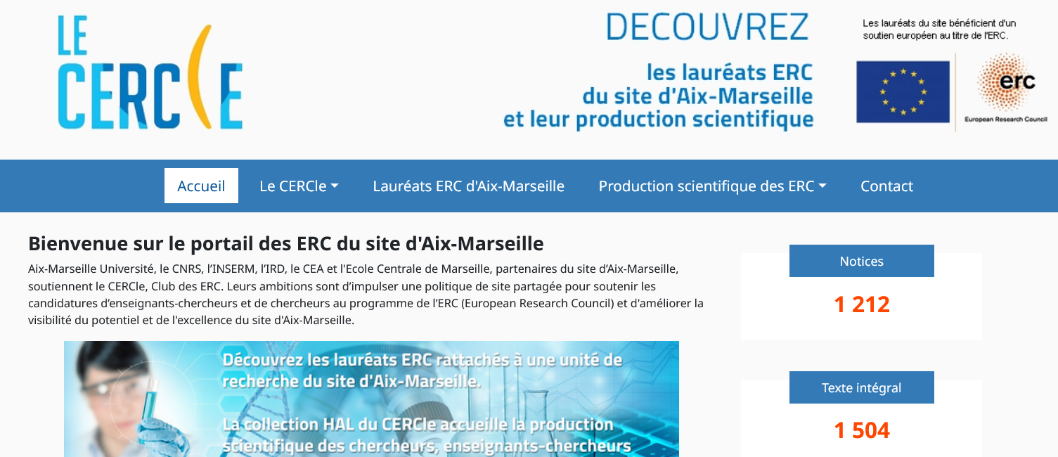
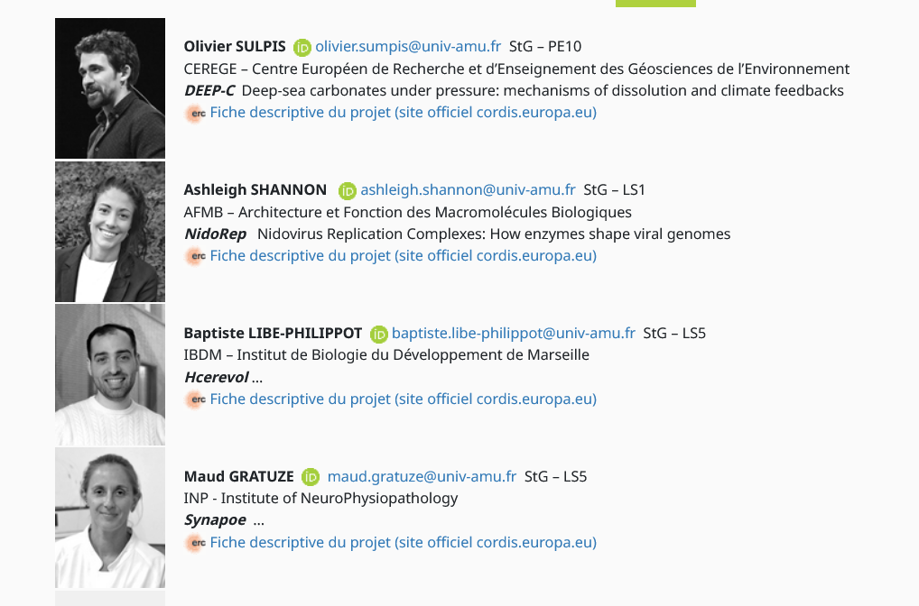
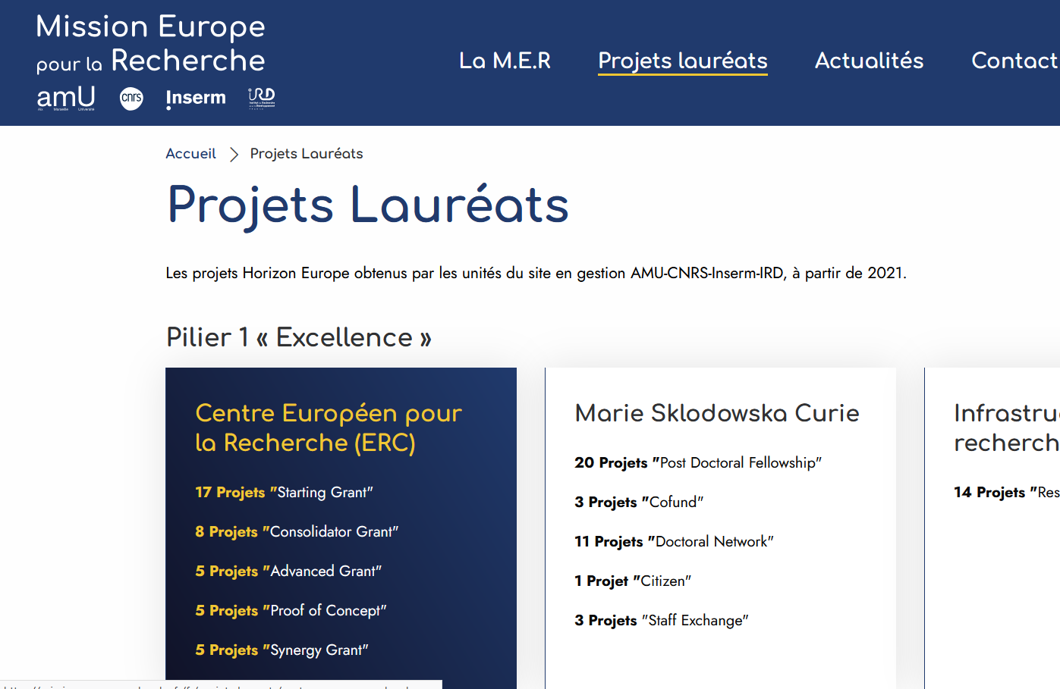
List of Laureates & profile
Site MER https://mission-europe-recherche.fr/fr/projets-laureats
Site HAL CERCLe https://amu.hal.science/CERCLE/

Slide 11
Overview of the ERC projets of Aix Marseille under HE
Application & Sucess rate
185 Submitted projects
39 succesfull applications (incl. 32 laureates)
21% success rate (53 proposals with pending results)
Pending results (reserve list &AdG)

Slide 12
Types of projects

Slide 13
Focus on ERC laureates per panel since 2007
LS panel: 42%
Since FP7: > 119 ERC projects > 101 laureates
PE panels: 40%

Slide 14




ERC excellence: Scientific Production insight
Aix Marseille ERC Laureates above quality average
Reflects the selection quatity of ERC
Reflects the quality of support provided in Aix-Marseille
Auto-censure (censorship) ???
2019-2024 | Web of Science | International Collaborations | Top 1% | Top 10% | Q1 Journals | All Open Access | Category* Normalized Citation Impact
ERC laureates of A-M | 2.543 | 2169 85% | 140 5,5% | 687 27% | 1720 78% | 2390 94% | 2,6
Researchers A-M | 40.117 | 24370 61% | 1005 2,5% | 5938 15% | 22103 59% | 29009 72% | 1,63
France | 20.793.942 | 22% | 1% | 9% | 46% | 46% | 0,97
ERC | 139.684 | 63% | 3,3% | 22% | 71% | 84% | 1,9
Data from the WoS analysed with
* 1 : world average

Slide 15
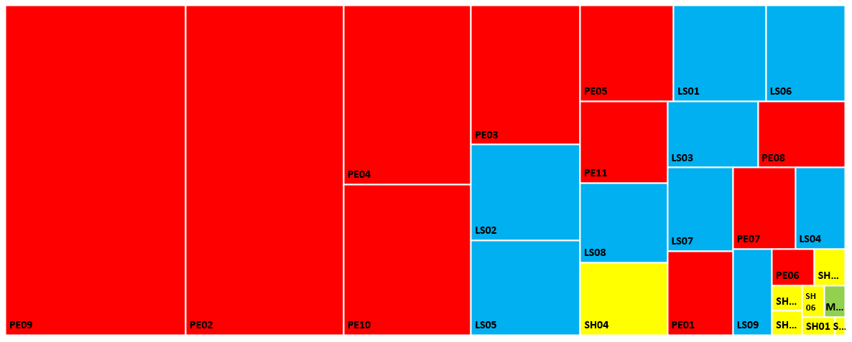
AMU Scientific Production per panel (ERC funding mentionned in publications)
Weigth of publications does not reflect nb of laureates panel
ERC boosts international collaborations (co-publications)!

Slide 16
Le CERCle Overview of our joint local initiative
Main activities

Slide 17

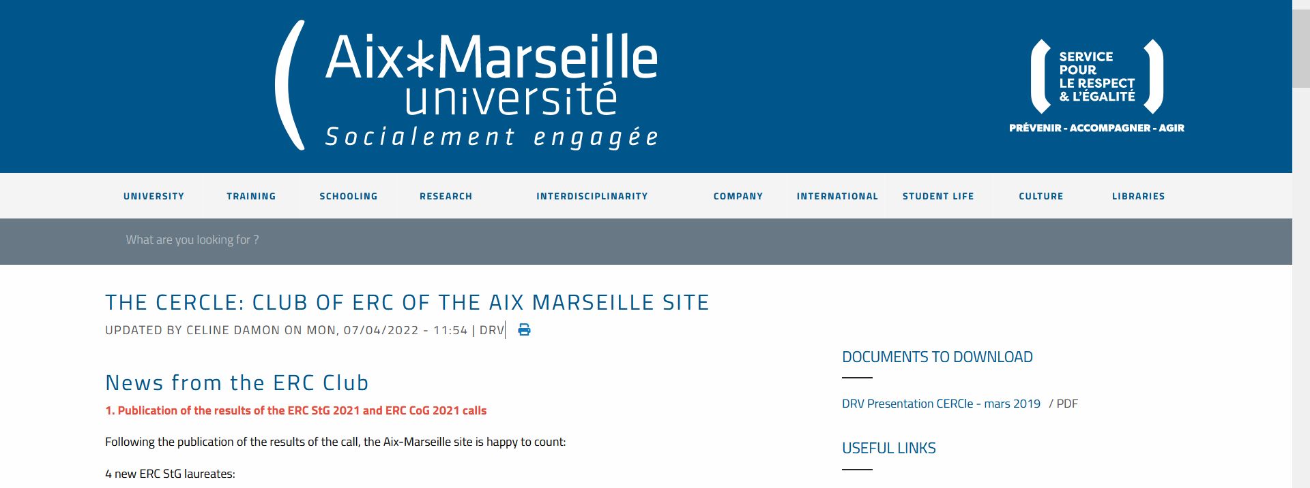
Le CERCle in a nutshell
Members of LE CERCle:
Laureates of a completed or ongoing ERC project
Current or former members of an ERC panel
Meet the laureates:
Collection HAL CERCle
Follow us on this internet page & MER Newsroom
119 ERC projects since the launch of CERCle in Aix Marseille
→ 31 ERC laureates (42 projects) in HE
41 laureates (49 projects) in H2020
29 laureates (32 projects) in FP7
incl. 10 ERC Proof of Concept
13 panel members
Notes:
TO UPDATE FOR 2024 JULIE (Joana updated number of panel members)
• 92 ERC projects on site since the launch of the
European Research Council (ERC) in 2007
• 11 ERC projects in the Horizon Europe programme (2021-2028)
• 49 ERC projects in the Horizon 2020 programme (2014-2020)
• 32 ERC projects in the FP7 programme (2007-2014)
• 5 projects have benefited from an ERC Proof of
Concept project in the H2020 programme

Slide 18

Le CERCle: objectives & activities
Our objectives promote your scientific excellence
• Encourage (teacher-)researchers to apply to the ERC and create a scientific dynamic.
• Improve the visibility of our Aix-Marseille site’s scientific excellence, strengthening our attractiveness.
• Support the dynamics of the site to strengthen our position as a major European research hub.
Our actions continually expand to support you
• Coaching sessions for ERC applicants, with the ERC National Contact Point (NCP)
• Writing workshops for ERC proposal preparation
• Masterclasses with the local laureates and the ERC National Contact Point (NCP)
• ERC interview preparation with collective and individual trainings
• Information sessions for each ERC grant type, open to anyone
• CV and bibliometrics benchmarking for project submissions
• Analysis of local ERC results & Feedback interviews with interviewed candidates
• Strengthening the visibility our local laureates and enhancing their bibliometry
• Annual plenary session, with project presentations by the candidates selected for funding
Our activities offer you tailored scientific advising
• CERCle provides all (teacher-)researchers who are submitting an ERC project with individualised coaching.
• Our team leads a joint strategic reflection to strengthen the participation of local research teams to the ERC.
• We stimulate interactions between site teams to participate in ERC and other EU programmes.
Notes:
Return = was done during FP7 and H2020, interrupted due to lack of human resources; the process of picking up the work where it was stopped has started.

Slide 19
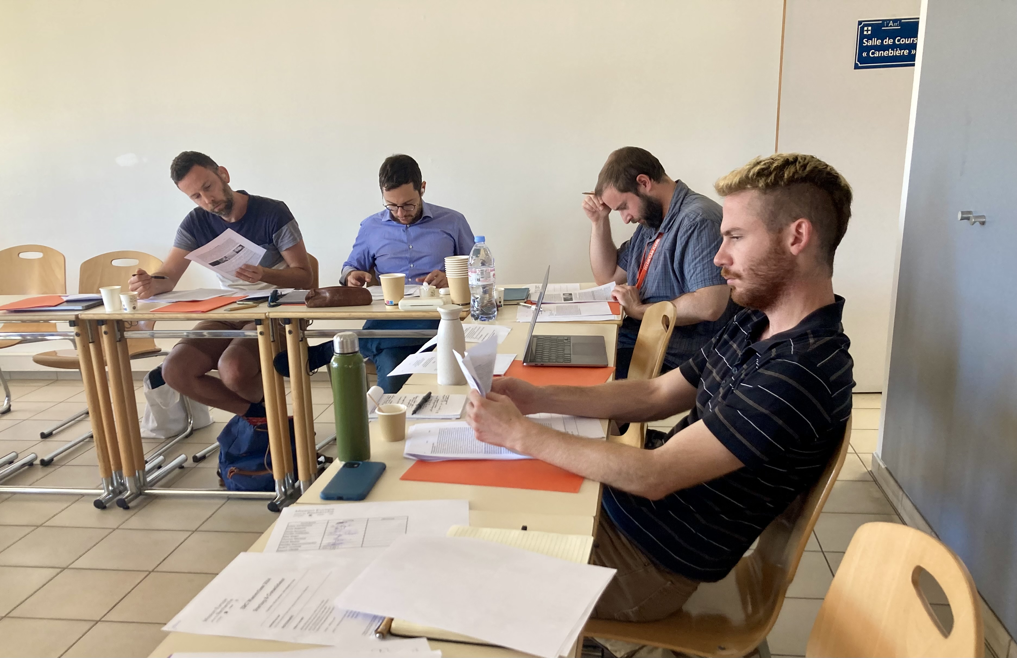
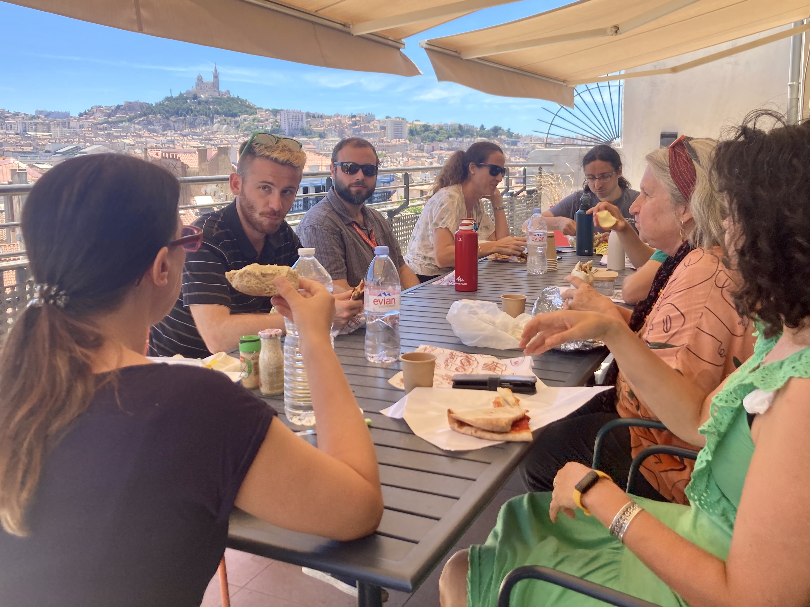
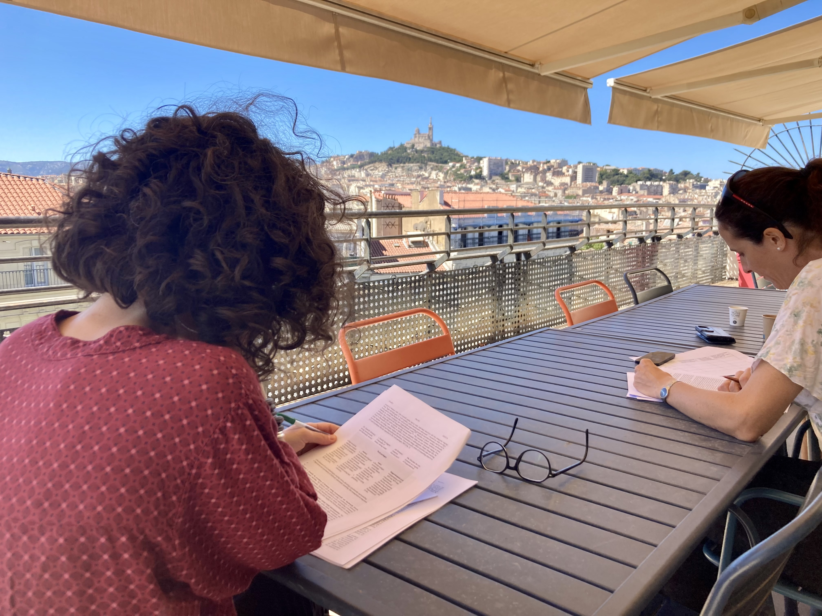
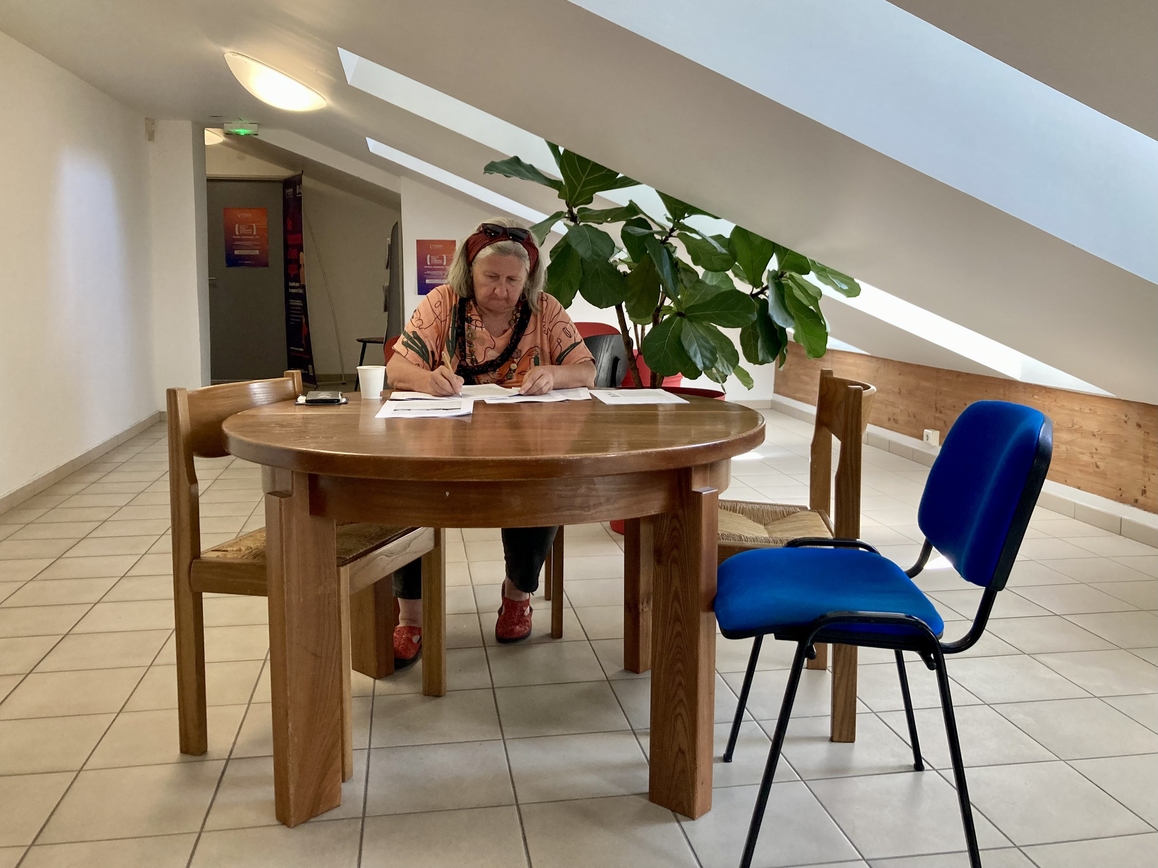
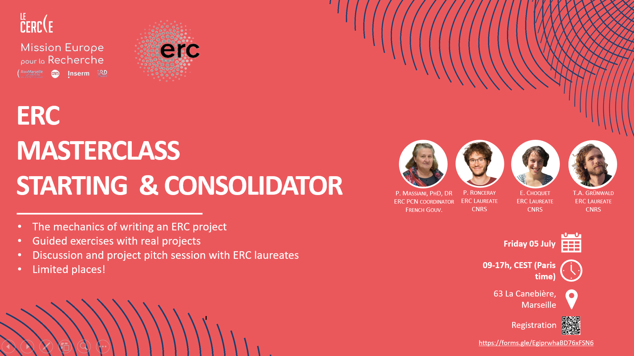
Masterclass
Deep work with the former National ERC Contact Point coordinator, Dr. P. Massiani and local laureates
CERCle activities are coordinated and implemented by a team of highly motivated, international former academics, in fields from the life sciences,
science and technology, and the social sciences and humanities
Notes:
12 participants, including SSH
This event was entirely conceptualized by the CERCle and MER team and was a success – we received very positive feedback from the participants and will certainly repeat it.

Slide 20
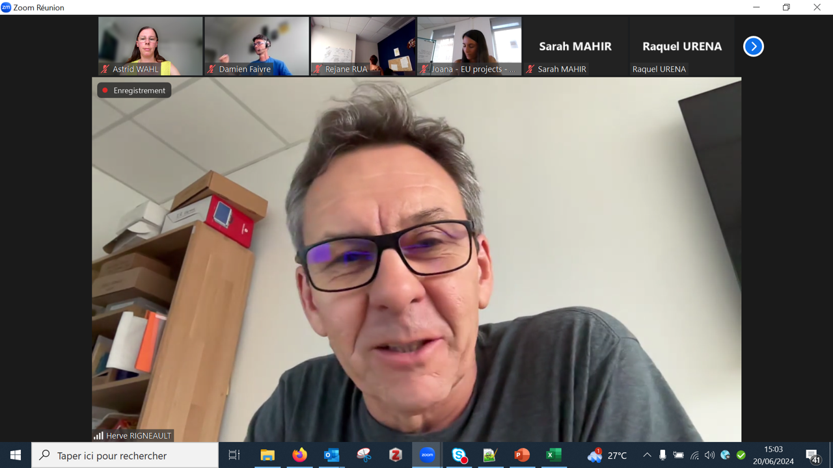
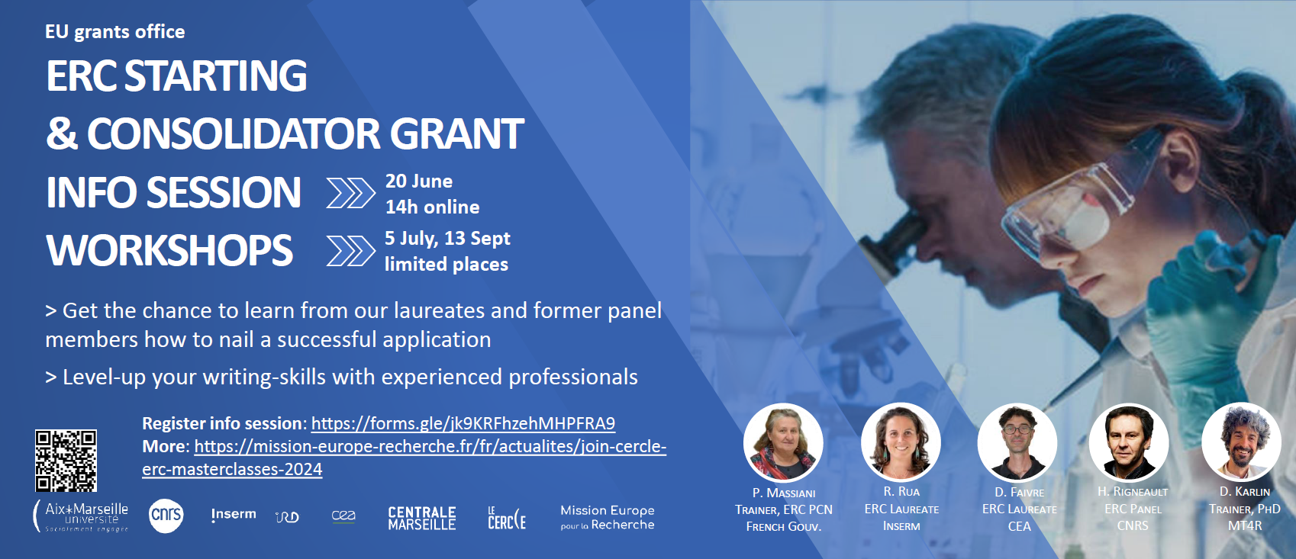
Information sessions
With laureates, panel members and the National ERC Contact Point
Two sessions in 2024: StG-CoG, AdG
70 Participants, including external
Three planned for 2025

Slide 21
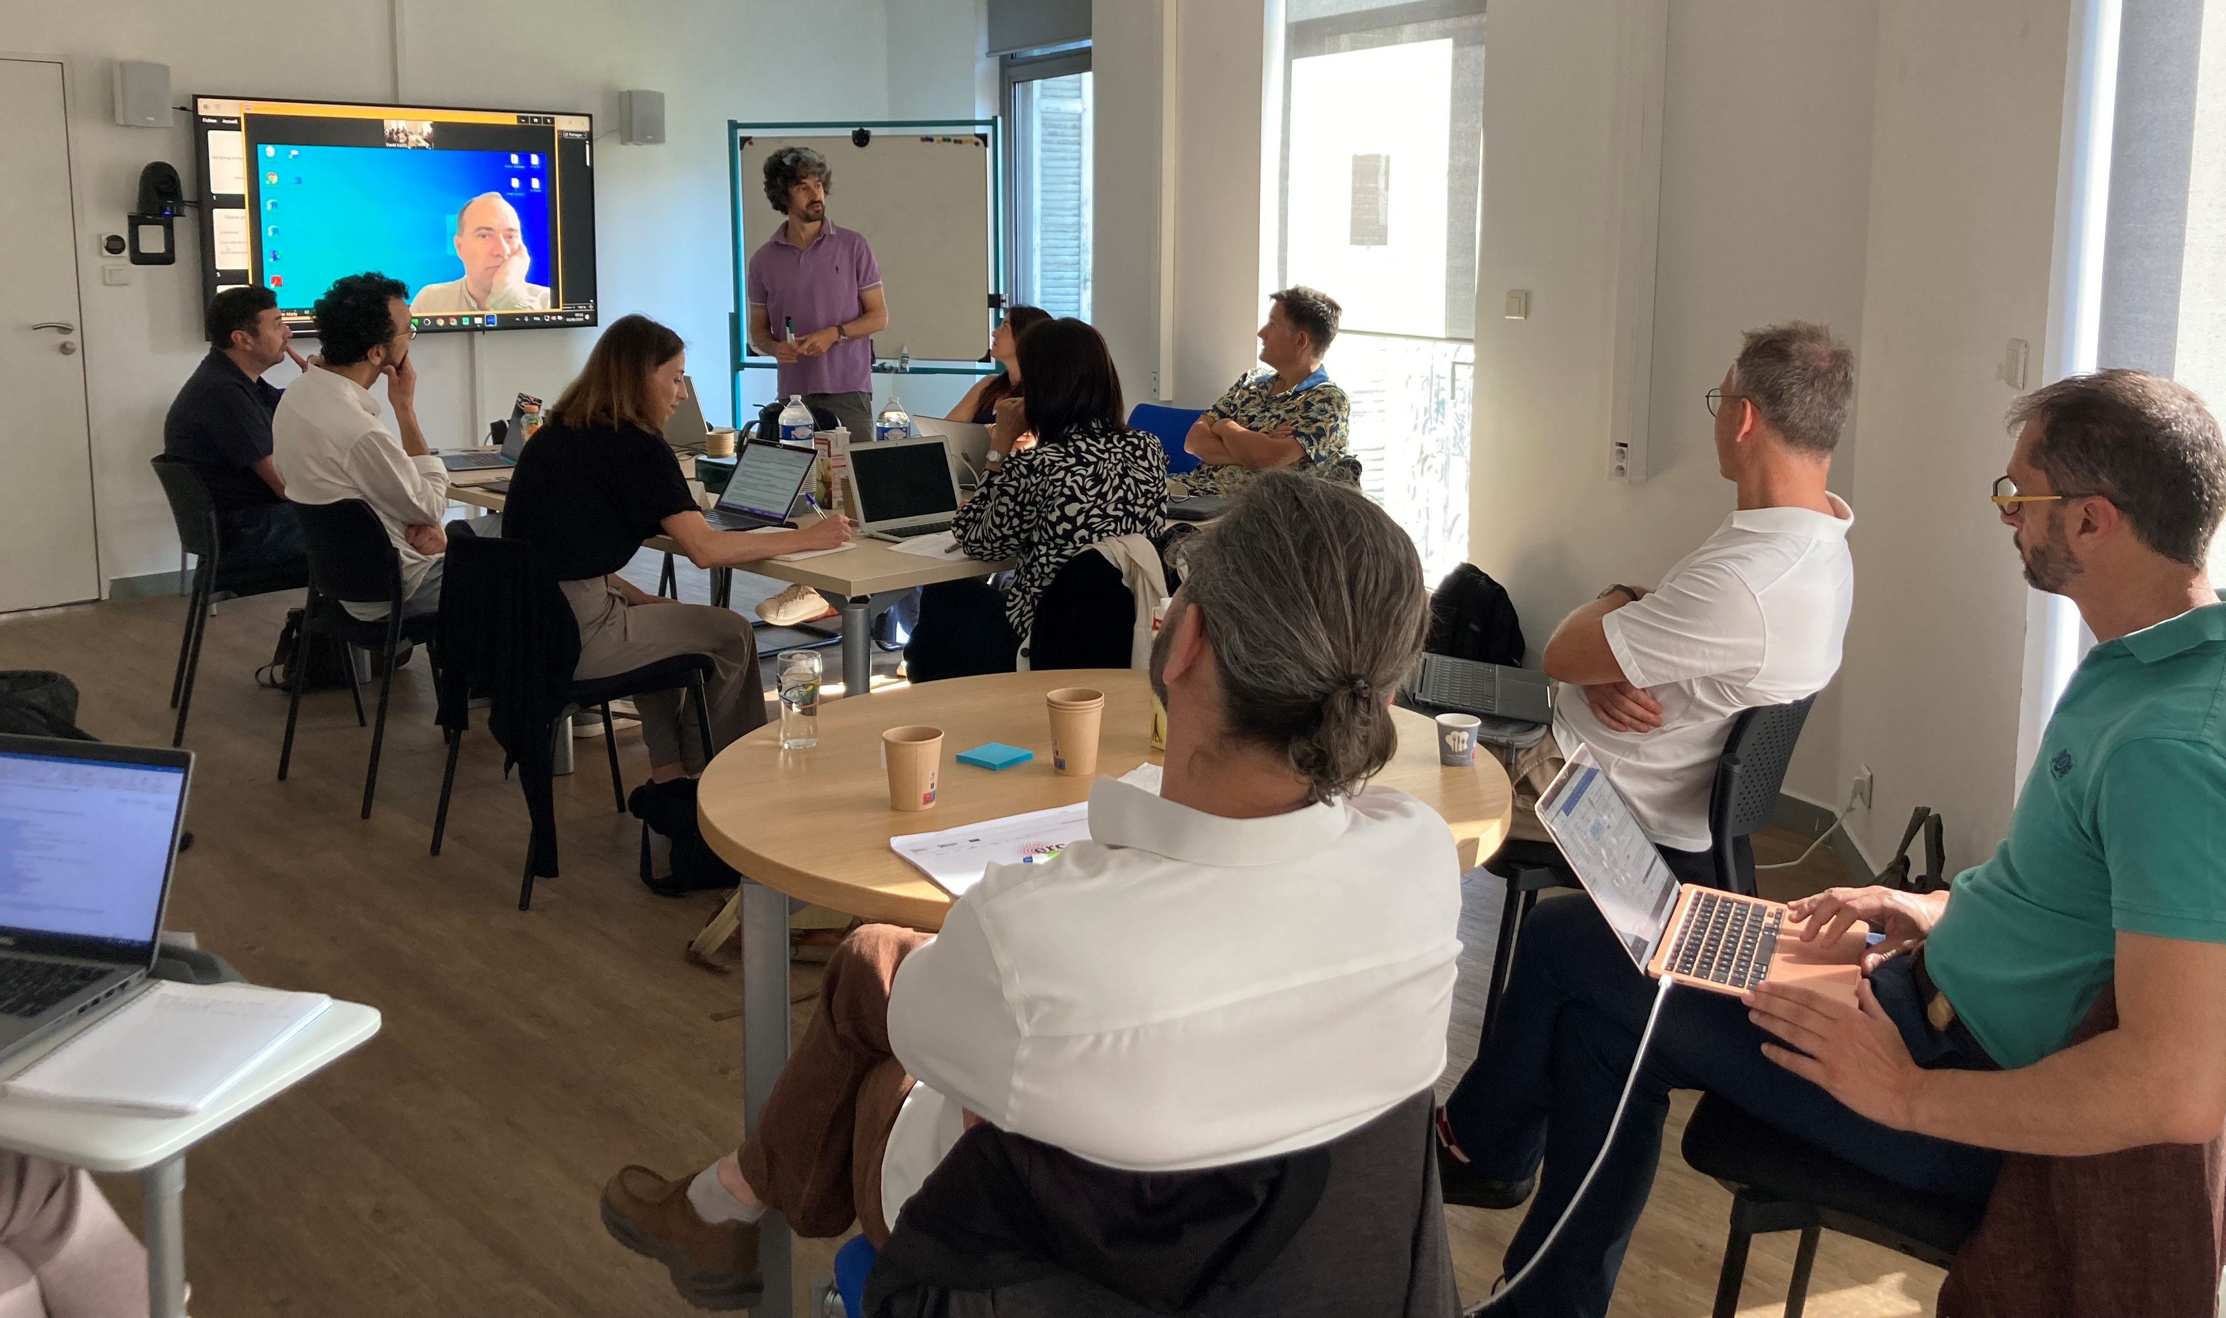
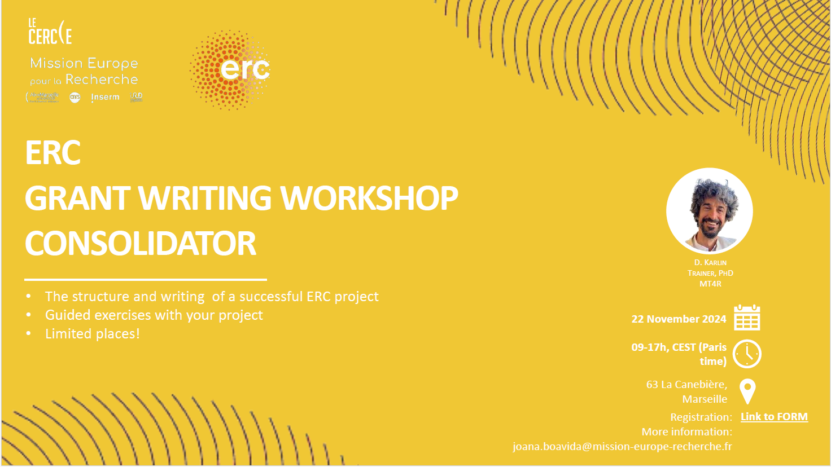
Grant writing workshops, all ERC levels
With specialised coach, former academic
Three writing workshops in 2024: StG, CoG, AdG
Three planned for 2025, including SyG
Special efforts in 2025 for SH panels
Notes:
Except POC
Total 23 participants in 2024 (limited number of places to 8 per session)
External coach fees kindly offered by CERCle
Hands on approach, exercises on site for candidates advanced in their project conceptualization and writing
Workshops and Coach’s method are highly appreciated by participants and methos is proven a success

Slide 22
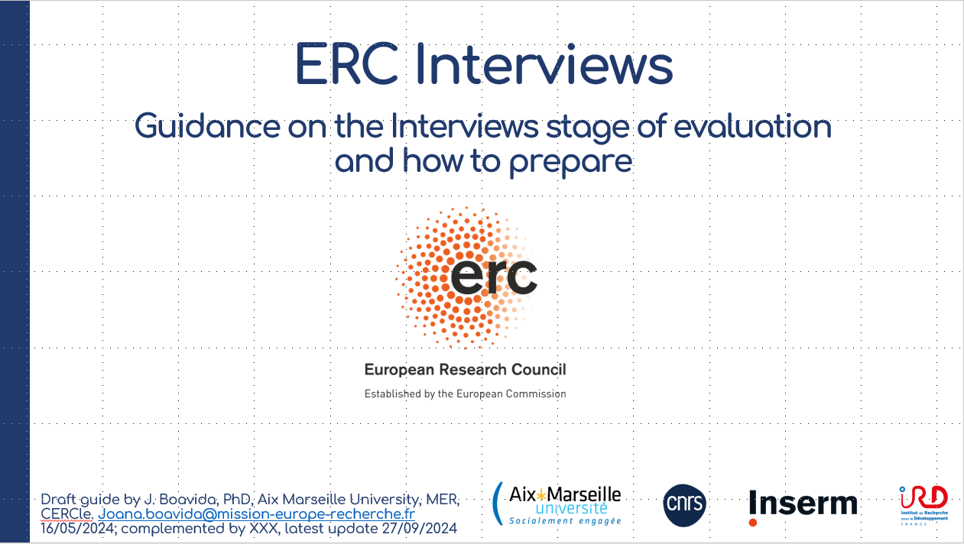

ERC interview preparation, all ERC levels
Collective and individual sessions
Three collective sessions planned for 2025
First one Jan-Feb 2025 for the ERC AdG A-invited candidates (5+, or ~20% of submitted)
Notes:
5+ because results are not final yet

Slide 23
Scientific presentation ERC Laureates
(2/2)

Slide 24
Maud Gratuze
SynApoE: Mechanisms of Synaptic Degeneration in Alzheimer’s Disease StG 2024 – LS05
INP – Institut de Neurophysiopathologie
Notes:
Isabelle Dautriche (ERC StG): ThoughtOrigins : Formative and Evolutionary Origins of the Language of Thought.
Olivier Sulpis (ERC StG): Deep-C :Investigating Environmental Geosciences.
Maude Gratuze (ERC StG): SynApoE: Mechanisms of Synaptic Degeneration in Alzheimer’s Disease.
Christian Henriot (ERC AdG and PoC): HistText : Big Data and Power Networks in Modern Urban China.
Kristof Strijkers (ERC CoG): LaDy: Language in Dyads: Connecting Linguistic and Neural Alignment.

Slide 25
Christian Henriot
ENPMUC: Big Data and Power Networks in Modern Urban China AdG 2017 and PoC 2024 – SH6
IrAsia – Institut de Recherches Asiatiques
Notes:
Isabelle Dautriche (ERC StG): ThoughtOrigins : Formative and Evolutionary Origins of the Language of Thought.
Olivier Sulpis (ERC StG): Deep-C :Investigating Environmental Geosciences.
Maude Gratuze (ERC StG): SynApoE: Mechanisms of Synaptic Degeneration in Alzheimer’s Disease.
Christian Henriot (ERC AdG and PoC): ENPMUC : Big Data and Power Networks in Modern Urban China.
Kristof Strijkers (ERC CoG): LaDy: Language in Dyads: Connecting Linguistic and Neural Alignment.

Slide 26
Kristof Strijkers
LaDy: Language in Dyads: Connecting Linguistic and Neural Alignment CoG 2024 – SH4
LPL - Speech and Language Lab
Notes:
Isabelle Dautriche (ERC StG): ThoughtOrigins : Formative and Evolutionary Origins of the Language of Thought.
Olivier Sulpis (ERC StG): Deep-C :Investigating Environmental Geosciences.
Maude Gratuze (ERC StG): SynApoE: Mechanisms of Synaptic Degeneration in Alzheimer’s Disease.
Christian Henriot (ERC AdG and PoC): HistText : Big Data and Power Networks in Modern Urban China.
Kristof Strijkers (ERC CoG): LaDy: Language in Dyads: Connecting Linguistic and Neural Alignment.

Slide 27
Demystifying the ERC and Encouraging Applications
Gerd Gigerenzer
Vice-President for Humanities of the European Research Council

Slide 28
Q&A session

Slide 29
Concluding Remarks
Stefan ENOCH
Vice President for Research Aix Marseille Université

Slide 30
THANK YOU!

